Slide 1

Strategy Pattern
Behavioral, Object focused

Slide 2

Motivation
Many possible algorithms exist to solve a given problem
Hard-wiring each algorithm into each instance becomes intractable
Different algorithms may be appropriate in different situations
Difficult to integrate new algorithms if code is hard-wired

Slide 3
Example
A fighting game has characters with similar interfaces: move, jump, kick, and punch. But each fighter has a unique way of performing each action (ice punch, fire kick, etc.) and some fighters share some of these actions.
How can we give each character their unique set of actions while minimizing repeated code and allowing characters to change actions during runtime?

Slide 4
Solution
Define classes that encapsulate different algorithms
An algorithm encapsulated this way is called a strategy

Slide 5
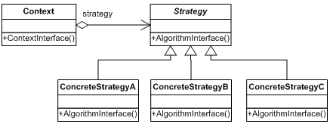
Structure
Strategy (Compositor)
Declares the common interface for all supported algorithms
Concrete Strategy
Implements the algorithms using the strategy interface
Context (Composition)
Configured with a concrete strategy object
Maintains reference to strategy object
May define interface to allow strategy to access its data

Slide 6

Consequences
Pros:
Families of related algorithms
Inheritance factors out common functionality of algorithms
Alternative to subclassing
Allows varying the algorithm independently from the context
Strategies eliminate conditional statements
Offers different implementation of the same behavior
Cons:
Incurs communication overhead between algorithm and context
Increases the number of objects

Slide 7
Example from “Design Patterns: Elements of Reusable Object-Oriented Software”
Erich Gamma
Richard Helm
Ralph Johnson
John Vlissides

Slide 8
Back to Lexi
Document structure: Composite Design Pattern
Formatting : Strategy Design Pattern
Embellishing the user interface: ?
Supporting multiple look-and-feel standards: ?
Supporting multiple window systems: ?
User operations: ?
Spelling checking and hyphenation: ?

Slide 9
Problem
Using the Composite Pattern, we defined an internal structure that Lexi can use to iterate through components, but that doesn’t give us the formatting of those components, what if the user changes the margins? If we are using the internal structure as it is, we would have to rearrange the components

Slide 10
Formatting
Definition: Breaking a collection of glyphs into lines, lines into columns, and columns onto pages.
Many complex methods exist for formatting
We want to keep them self contained and independent of the document structure
Adding a new Glyph should not affect the code (black-box reuse)
This is done by ISOLATING and ENCAPSULATING the algorithm into an object

Slide 11
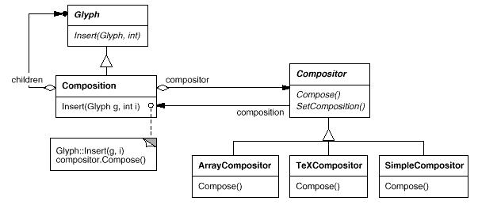
Formatting
Let’s define a separate class hierarchy for formatting algorithms
The root (compositor) will define the interface
Subclasses implement a specific algorithm
A Glyph subclass can structure its children for the given algorithm object

Slide 12
Compositor and Composition
The Compositor class encapsulates the formatting algorithm
The interface lets the compositor know what glyphs to format and how to do the formatting
The glyphs formatted are children of the special Composition glyph subclass

Slide 13
Basic Compositor Interface
Responsibility | Operations
What to format | void SetComposition(Composition*)
How to format | virtual void Compose()

Slide 14
How to use the Composition and Compositor
A Composition gets an instance of a Compositor subclass
The compositor subclass implements a specific formatting algorithm
An unformatted Composition object contains only visible glyphs making up the document’s content
Glyphs determining the physical structure (Row and Column) are not contained
To format, the Composition calls compositor.Compose()
The Compositor iterates through the Compositions children and inserts new Row and Column glyphs according to the Compositor algorithm

Slide 15
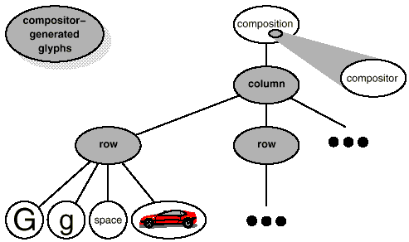
How to use the Composition and Compositor
The Compositor iterates through the Compositions children and inserts new Row and Column glyphs according to the Compositor algorithm

Slide 16
Benefits
The Compositor-Composition class split ensures a separation between code for the physical structure, and formatting algorithm code
Adding a new Compositor subclass does not affect the glyph classes
Adding a new Glyph subclass does not affect the Compositor classes
Using dynamic binding, the line-breaking algorithm can be changed at run-time through the SetCompositor() operation

Slide 17
Strategy Pattern Review
Encapsulating an algorithm in an object is the intent of the Strategy Pattern
The key participants in the pattern are Strategy objects (compositor) and the context (composition)
The key to applying the Strategy pattern is designing interfaces for the strategy and its context that are general enough to support a range of algorithms
Follow the Three Strikes and Refactor rule

Slide 18


Questions?

